Slide 1
SPEECH AND LANGUAGE THERAPY
Sharnae Salmon
Specialist Speech and Language Therapist

Slide 2
Outline
What is Speech and Language Therapy?
Why am I talking to you today?
How does the swallow work?
What is dysphagia and how is it managed?
What is reflux and how is it managed?

Slide 3
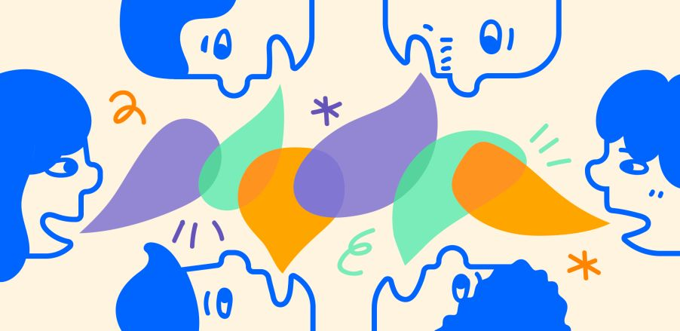
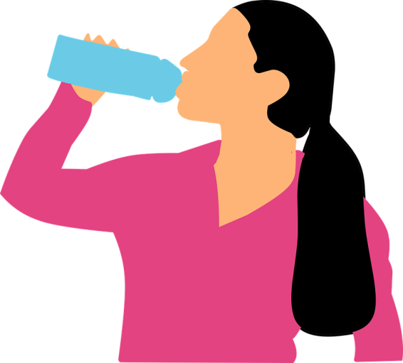
Speech and Language Therapy
Communication
Swallowing

Slide 4
Why am I talking to you?
Notes:
Wolfram syndrome can impact your swallowing.

Slide 5
Normal Swallow
Pre oral stage
Oral Stage
Pharyngeal Stage
Oesophageal Stage

Slide 6
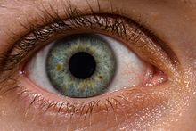
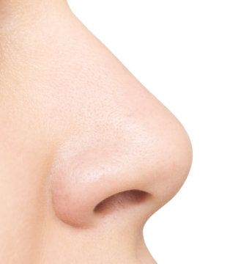
Pre-oral stage
See the bolus
Smell the bolus
Salivary flow
Lips open
Jaw opens
Placement of bolus (food or drink in oral cavity)

Slide 7
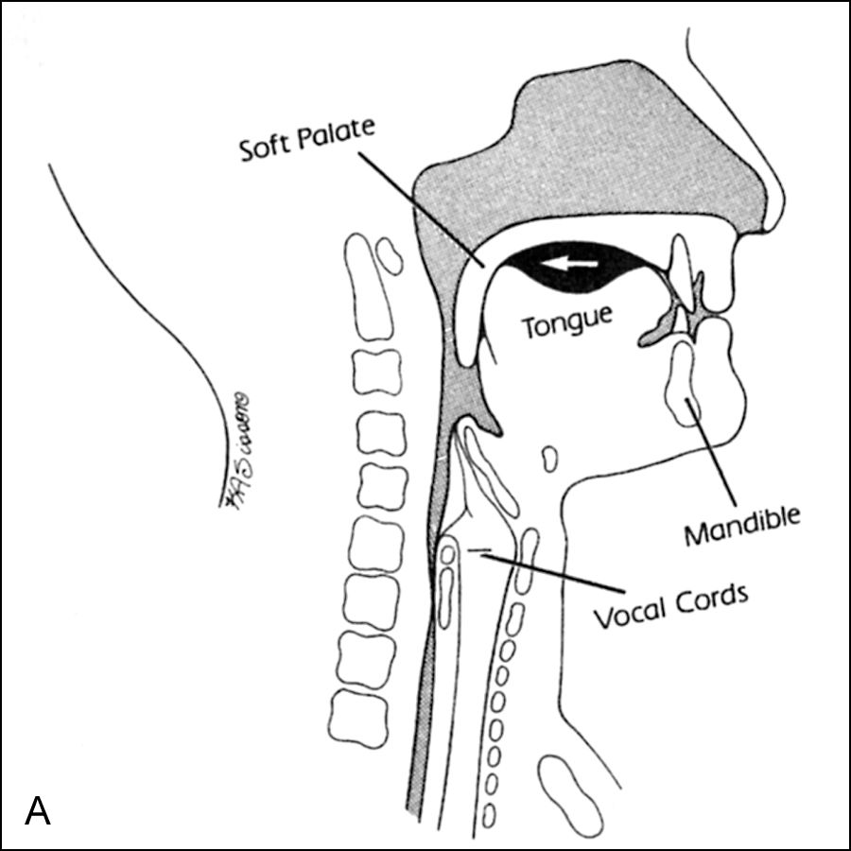
Oral Stage
Lip seal- keeping food in your mouth,
Supporting the movement of the bolus around your mouth and towards your throat
Chewing and manipulating food in your mouth
At this stage your Airway open

Slide 8
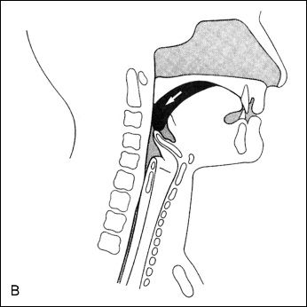
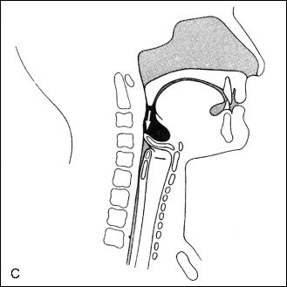
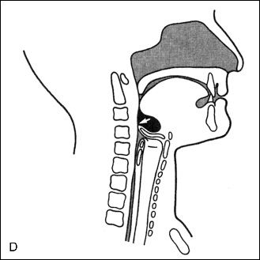
Pharyngeal Stage
Swallow triggered
Soft palate raised to stop food from entering the nasal cavity
Your airway closes
Cricopharyngeal sphincter relaxes
Food or drink enters the oesophagus (food pipe)
Notes:
Add picture

Slide 9
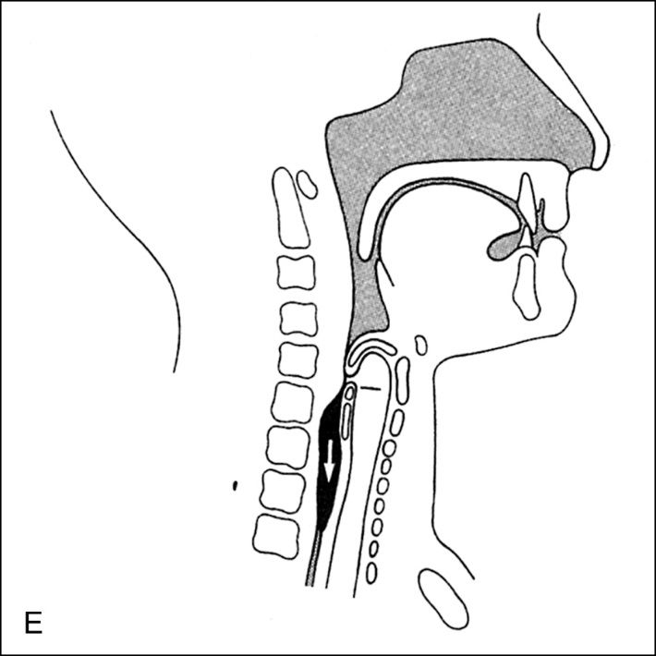
Oesophageal Stage
Airway re-opens/ normal breathing resumed
Peristalsis ( a wave like motion) occurs in the muscles of your oesophagus to help moves the bolus towards the lower oesophageal sphincter
Notes:
Add picture

Slide 10
What is Dysphagia?
The medical term for swallowing difficulties.
Difficulties can occur due to a break down at any of the 4 stages of the swallow.

Slide 11
Dysphagia and Wolfram Syndrome
Vision
Smell
Movement/coordination
Respiration
Swallowing
Gastro-intestinal issues

Slide 12
Signs of Dysphagia
Signs often include:
Coughing
Choking
Wet gurgly voice
Chest infections/aspiration pneumonia
Pain on swallowing
Feeling of something stuck in throat
Reduced oral intake

Slide 13
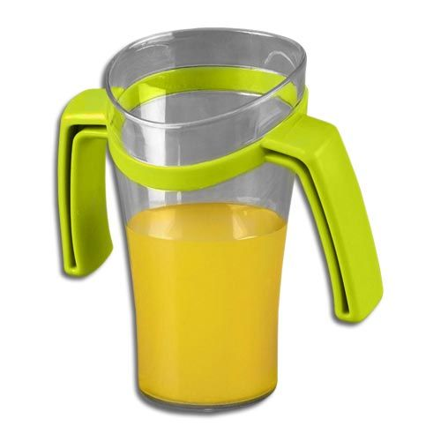
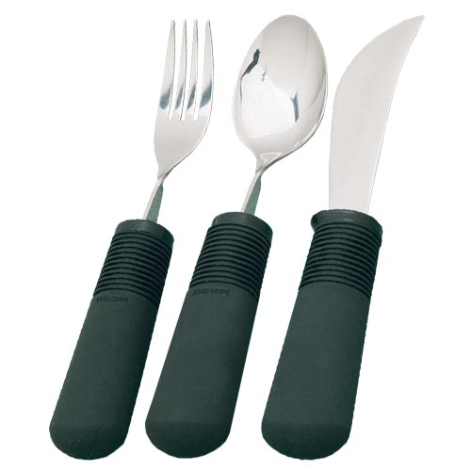
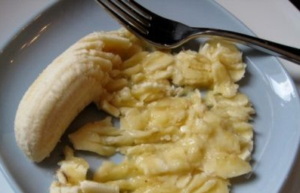
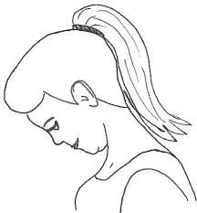
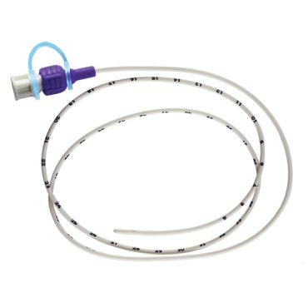
Dysphagia Management
Postures
Strategies
Diet & fluid modification
Therapy
Non-oral nutrition
Surgical intervention

Slide 14
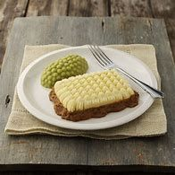
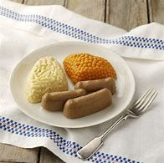
Modified Fluids and Diet - IDDSI
https://iddsi.org/framework/

Slide 15
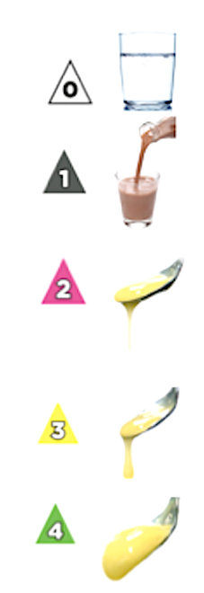
Modified Fluids
Modifying fluids by increasing the thickness of the fluid.
Thicker fluids can sometimes be easier to swallow:
Moves more slowly
Easier to control
It’s important that you follow the guidance given by the manufacturer and your Speech and Language Therapist, if recommended modified fluid.

Slide 16
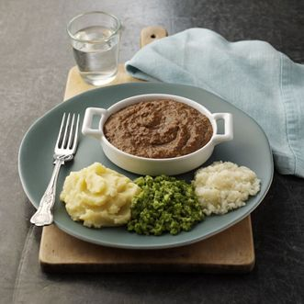
Modified Diet
Modifying the texture, e.g. softer food, extra sauces, mashable or ensuring there are no lumps of bumps, mixed consistencies.
Modifying size of the food pieces
Reduce how much chewing is required
Reduced risk of choking
Reduce residue in mouth/throat

Slide 17
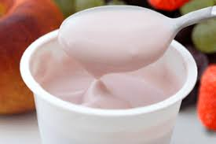
Why we modify diet and fluids
Compensate for weak or uncoordinated oral, pharyngeal or oesophageal muscles
Increase ease of chewing, clearing and swallowing
Increasing independence and quality of life
Reduce risk of aspiration/malnutrition
Reduce pain/discomfort

Slide 18
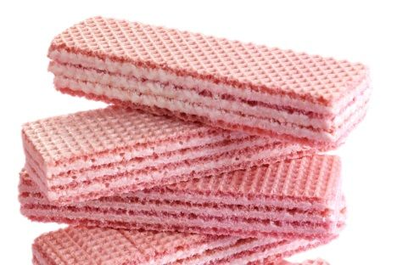
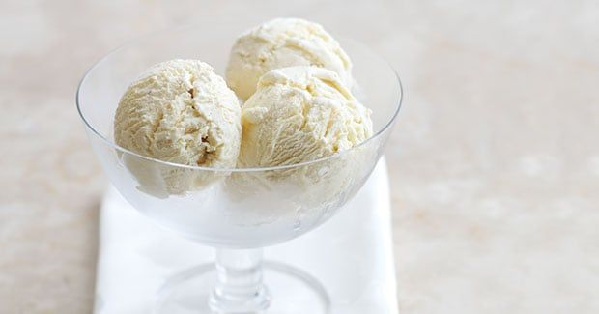
Transitional foods
Food that starts as one texture (e.g. firm solid) and changes into another texture when moisture (e.g. water or saliva is applied), or when a change in temperature occurs (e.g. heating)
Biting not required
Minimal chewing required
Tongue can be used to break foods down once altered by moisture or temperature

Slide 19
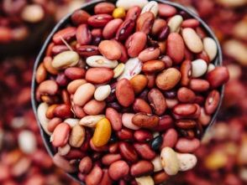
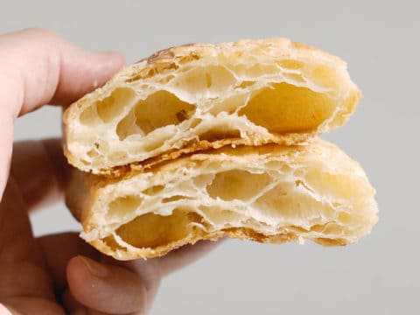
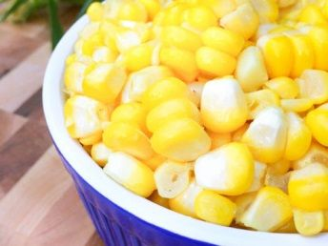
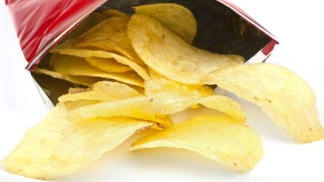
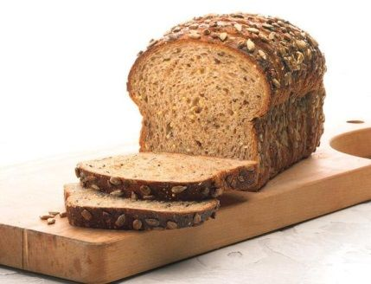
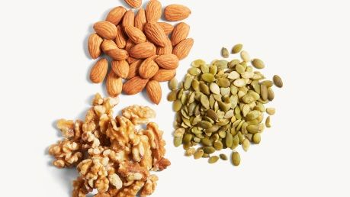
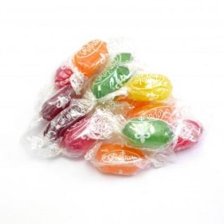
High Risk Foods
Stringy, fibrous textures e.g. pineapple, runner beans, celery, lettuce
Vegetable and fruit skins including beans e.g. broad, baked, soya, black-eyed peas, grapes
Mixed consistency foods e.g. cereals which do not blend with milk e.g. muesli, mince with thin gravy, soup with lumps
Crunchy foods e.g. toast, flaky pastry, dry biscuits, crisps
Crumbly items e.g. bread crusts, pie crusts, crumble, dry biscuits
Hard foods e.g. boiled and chewy sweets and toffees, nuts and seeds
Husks e.g. sweetcorn and granary bread

Slide 20
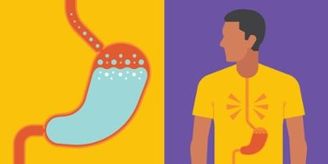
Reflux
Heartburn
Unpleasant taste in the mouth
Sore throat
Excess mucus in the throat
The feeling of a lump or tightness in the throat
Regular coughing or throat clearing
Dryness in the mouth or throat
Hoarse voice
Regurgitation of food or drink

Slide 21
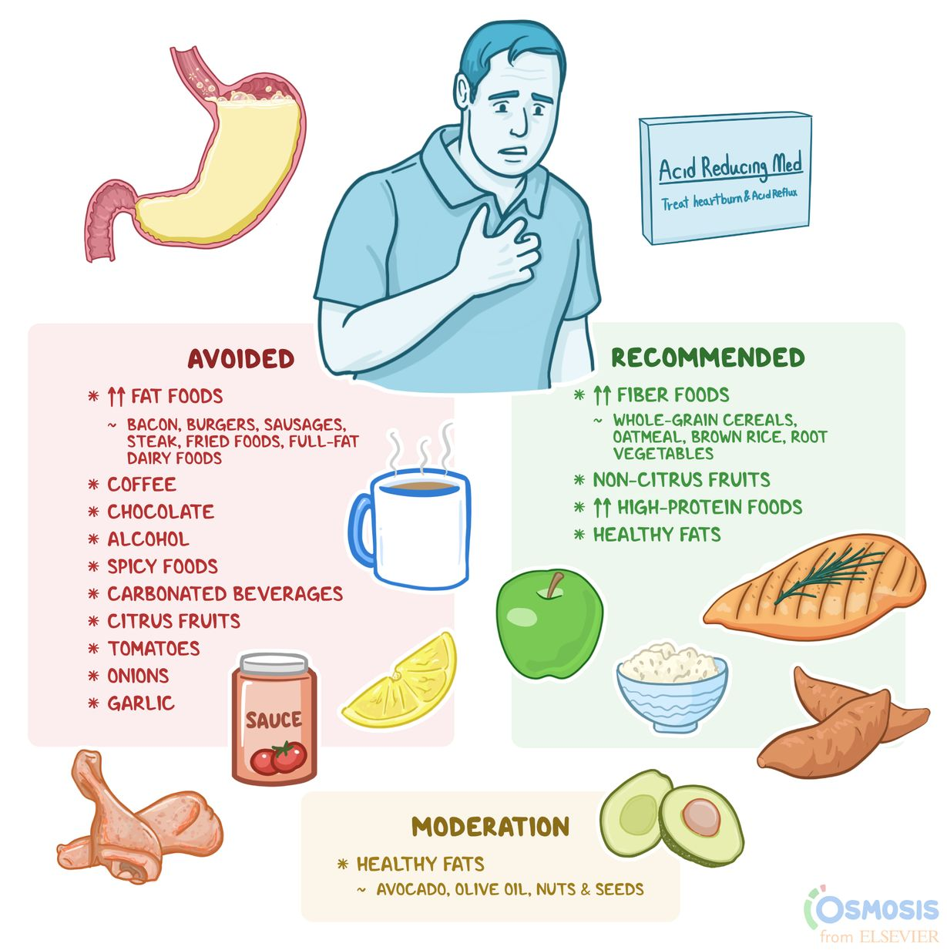
Reflux advice
Avoid eating late at night
Eat small frequent meals during the day
Avoid eating foods which can make reflux worse
Avoid fizzy drinks, caffeinated drinks, or highly acidic drinks
Avoid alcohol
Stop Smoking
Try raising the head of the bed
Try to lose weight if you are overweight
Avoid tight clothing around your waist
Seek advice from your GP

Slide 22
Do I need SLT?
Contact GP to request a referral to your local SLT.
Strategies:
Taking small, steadily paced, sips of fluid or mouthfuls of diet.
Trying not to talk straight after (or during) eating or drinking.
Reduce distractions when eating and drinking.
If you are having difficulty taking tablets, you may want to try taking them with a spoonful of yoghurt or custard to help them go down more easily.
Make a diary of your difficulties and look for patterns of swallowing difficulty
If you notice that particular food, drinks or situations regularly lead to difficulties with swallowing, please try to avoid these if it is practical to do so.

Slide 23
Thank you Any Questions?

